Slide 1
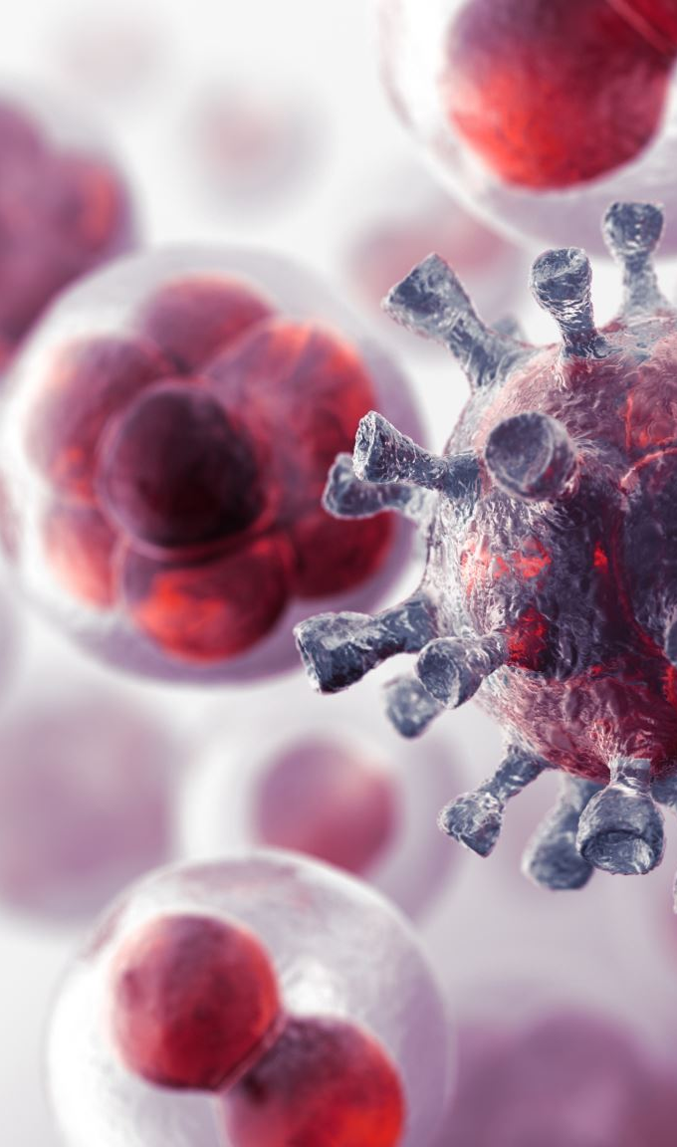
Predictive Model for Chronic Hepatitis B Infection
Group: Data Divers
Ahmed Bediwy
Farah Ahmed
Mubarak Mojoyinola
John Biju

Slide 2

Hepatitis B
The hepatitis B virus causes hepatitis B, a liver infection. The infection can be acute (short and severe) or chronic (long term).

Slide 3


GOAL
Develop and evaluate models for identifying people who Require screening for hepatitis B surface antigen (HBsAg)

Slide 4
NHANES Data Collection
NHANES 2013-2018
Demographics Data
Age, Gender, Race, Education, # of people in household, Annual income, Served active duty in US, Country of Birth, Marital Status, Pregnancy Status, Ratio of family income to poverty
Laboratory Data
Hepatitis B core antibody, Hepatitis B surface antigen
and Hepatitis B surface antibody

Slide 5
Questionnaires Data
Ever had hepatitis B, Ever received medicine for hepatitis B, Covered by private insurance, Covered by Medicare, Covered by Medicaid, Covered by any health Insurance
Type for work done last week, Hours of work done last week, Smoked at least 100 cigarettes in life, Current self-reported height (inches), Current self-reported weight, Income from wages/salaries

Slide 6
Data Manipulation Using NumPy & Pandas
Selected important columns from every dataset
Merged all datasets by Sequence
Convert object type features into integer type
Change the column names

Slide 7
Modeling Data
Total Observation 8221
Positive HBV cases 112
Negative HBV case 8109
Predictors
Gender
Age in years
Race/Ethnicity
Country of Birth
Household size
Family size
Ever told you have Hepatitis B?
Covered by health insurance
Education level
Current self-reported height (inches)
Current self-reported weight (pounds)

Slide 8
Modeling Strategy

Slide 9
We have 3 models 2 CV folds and 5 resampling methods
Models
CV folds
Resampling
None
Up
Down
Smote
Rose
Logistic Regression
Random Forest
Gradient Boosting
5 folds
10 folds

Slide 10

Model Evaluation
AUC
Accuracy
Specificity
Sensitivity

Slide 11
Final Model Performance
Logistic Regression– 5-folds - Down
AUC | ACCURACY | SPECIFICIITY | SENSITIVITY
0.7777 | 0.7383 | 0.7373 | 0.8182

Slide 12
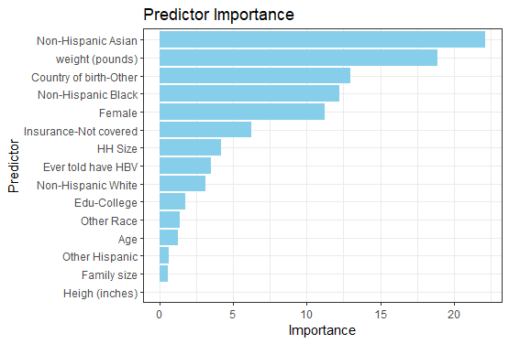
Predictor importance based on final model

Slide 13

Software Used
Data Collection and preliminary cleaning
Python (Numpy and Pandas)
Visualization
GGplot2 package in R / Python
Modelling
Caret package in R

Slide 14

Visualizations Implemented

Slide 15
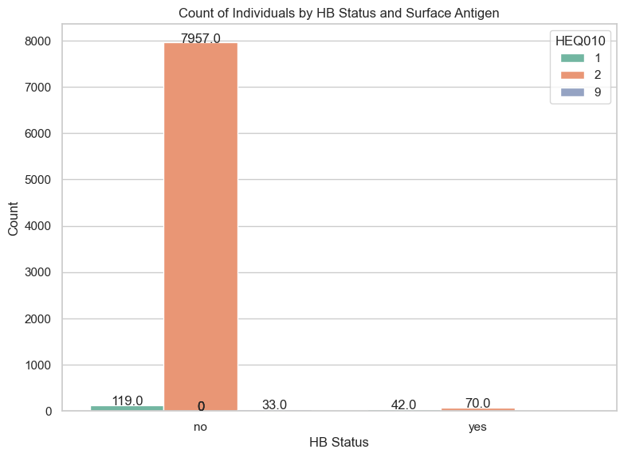

Slide 16
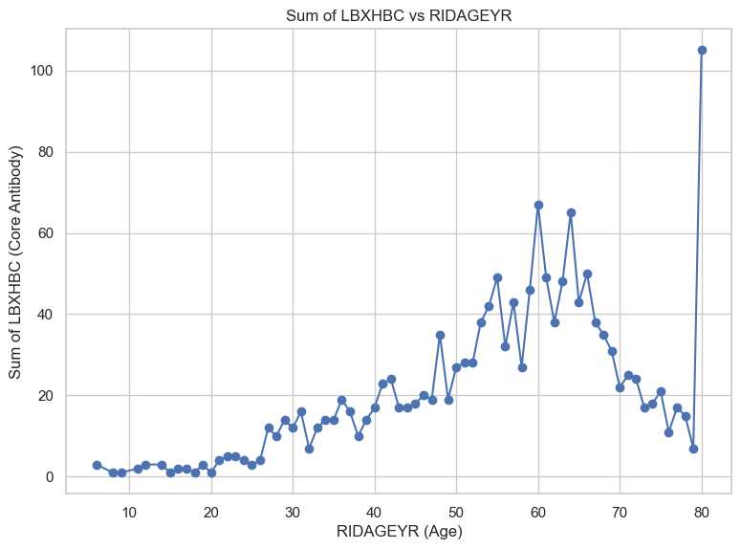
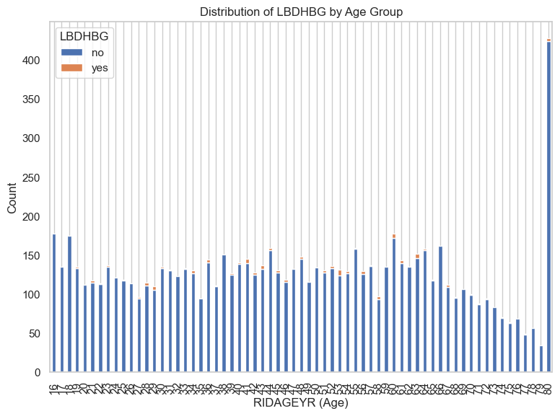

Slide 17
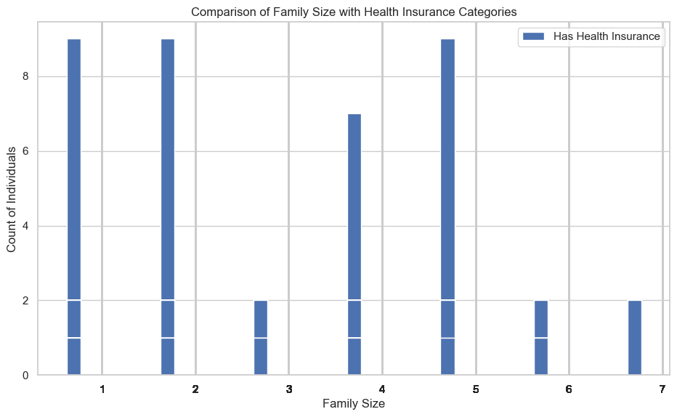
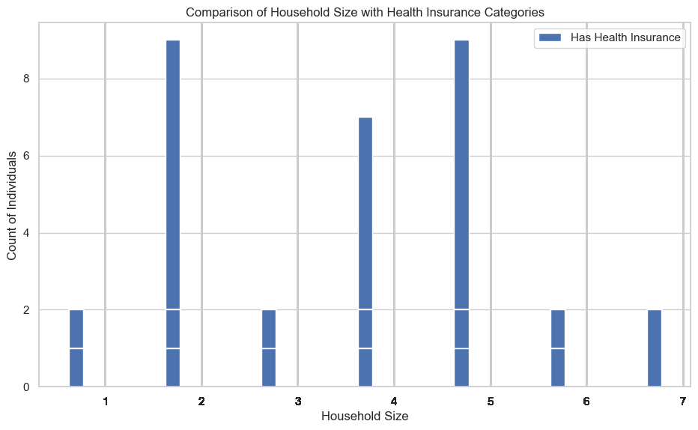

Slide 18
References
1. Harabor, V., Mogos, R., Nechita, A., Adam, G., Melinte-Popescu, A.-S., Melinte-Popescu, M., Stuparu-Cretu, M., Vasilache, I.-A., Mihalceanu, E. J. I. J. o. E. R., Adam, P. (2023). Machine Learning Approaches for the Prediction of Hepatitis B and C Seropositivity, *20*, 2380.
2. Holmer, R. (2018). Developing an HPV Infection Risk Prediction Model for Adult Females. *Industrial Engineering Undergraduate Honors Theses*. Retrieved from https://scholarworks.uark.edu/ineguht/55 (accessed November 5, 2023).
3. Tewari, P., Kashdan, E., Walsh, C., et al. (2021). Estimating the conditional probability of developing human papilloma virus-related oropharyngeal cancer by combining machine learning and inverse Bayesian modeling. *PLoS Comput Biol, 17*(8), e1009289.
4. Wang, Y., Du, Z., Lawrence, W. R., Huang, Y., Deng, Y., Hao, Y. (2019). Predicting hepatitis b virus infection based on health examination data of community population. *Int. J. Environ. Res. Public Health, 16*, 4842.

